Slide 1


Factual Consistency of Text Generation Systems
Hwanhee Lee
Notes:
Good afternoon. I’m Hwanhee Lee in ECE department at Seoul National University and thank you for inviting me to the campus. I’m really excited to be here to present my research. I’m a researcher in the field of natural language processing that allows computers to understand or generate human language. In this talk, I’ll introduce my research on factual consistency of text generation systems.

Slide 2
Outline
Introduction
Short Bio
What is Factual Consistency?
Part 1
How can we evaluate Factual Consistency?
Factual Consistency Evaluation
Part 2
How can we improve Factual Consistency of text generation system?
Improving Factual Consistency in Text Generation
Notes:
Here is the outline of today's talk. I start by briefly introducing my research career and the background of today's topic, the concept of factual consistency which is one of important criteria in text generation system. And then I'll introduce some of my past works about factual consistency evaluation that must be necessary in developing better text generation system. And then I'll introduce research on improving the factual consistency based on current & future works that use the evaluation metrics in my past works.

Slide 3




Short Bio
Introduction
Education
Seoul National University
Electrical and Computer Engineering
B.S.
Feb 2017
Ph.D.
Aug 2022
Advisor: Prof. Kyomin Jung
Distinguished Ph.D Dissertation Award
Research Experience
Published at NLP conferences
ACL, NAACL, and EMNLP
Research Intern
Collaborative Research
NAVER AI Lab
Adobe Research
Sorbonne Univ.
Aug 2021 - Jan 2022
NAACL-22
Nov 2019 – Current
ACL-21, NAACL-21, EMNLP-21
Jan 2021 – May 2021
EMNLP-21
Notes:
I just briefly introduce my research career. I majored natural language processing NLP, and I got Ph.D from ECE department at SNU with distinguished dissertation award, and I also got Bachelor's degree there. As a researcher in the field of NLP, I mainly published papers at top-tier NLP conferences like ACL, NAACL and EMNLP. I frequently collaborated with amazing research institutes from all over the world. I worked with NAVER AI LAB for a research intern, that resulted in a publication to NAACL 2022. Also, I fortunately published many papers through the collaboration with top research institutes in the world such as adobe research in USA and Sorbonne university in France.

Slide 4
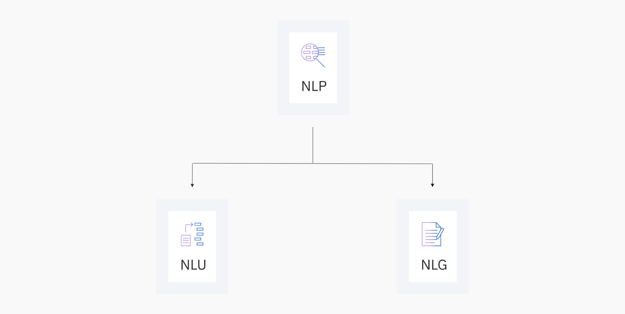
Research Interests
Introduction
NLP
Natural Language Processing
NLU
NLG
Natural Language Understanding
Natural Language Generation
Machine Reading Comprehension
Sentiment Analysis
Relation Extraction
…
Abstractive Summarization
Machine Translation
Dialogue Generation
….
Notes:
And as a researcher in the field of NLP, I'll just briefly introduce the taxonomy of this field including my research interests. Research problems in NLP are usually divided into two parts, natural language understanding, and natural language generation. The natural language understanding area contains tasks that aim to understand the contents of the human written text, such as machine reading comprehension that answers the question for a given passage or sentiment analysis which is to determine the sentiment of the given text. On the other hand, natural language generation deals with the problem of generating a human-like text such as summarization that generates a short summary, or machine translation that converts source language to target language or generating a human-like dialogue. Among these two research areas, I am especially interested in natural language generation tasks.

Slide 5
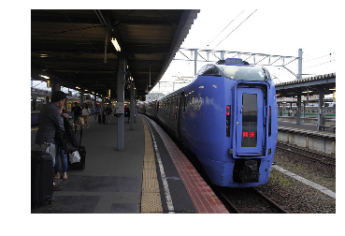
Introduction
Research Interests: Text Generation
Article
Scientists from harvard have discovered a way of turning stem cells into killing machines to fight brain cancer. (…)
Summarization
Image Captioning
Summary
Scientists in the US have developed a stem cell therapy for brain tumours.
Caption
A blue subway train pulls into the subway station.
unimodal
multimodal
Research Question
How can we develop a better text generation system?
Notes:
Among various natural language generation tasks, I have mainly conducted research on these two tasks, an abstractive summarization and an image captioning. An abstractive summarization is a task that aims to generate a short summary that contains important fact for a given document like news article as in this example. And image captioning aims to generate a short text to describe the content for a given image. Different from an abstractive summarization task, an image captioning task is a multimodal task that uses both visual and textual data. I have interests in both unimodal and multimodal text generation tasks. Then, how can we develop a better text generation system for these tasks? This is one of the main research questions in today’s talk.

Slide 6
Introduction
What is Important in Text Generation?
Grammatically Correct
Fluency
Interesting
Understandable
Notes:
Then, what is important in text generation? let’s think about the criteria to evaluate the generated text. When we evaluate the text, which criteria should be used? There are some criteria that we have to consider when evaluating the generated text in this slide. For example, we have to check whether the generated text is grammatically correct or we have to check the fluency of the generated text. And sometimes, we may require the system to generate interesting and understandable text when building a chatbot for the user.

Slide 7
Introduction
Evaluating Text Generation Systems
Does this caption describe the image well?
Caption 1
A red train pulls into the train station.
The color of this train is blue.
Notes:
Then, let's evaluate this caption considering what's important in the text generation system. Does this caption describe the image well? We can easily think that this caption is totally wrong. Although this caption is a grammatically correct and fluent sentence at first glance. But if we look at the image, we can easily find that the caption described the blue train as a red train, which is completely wrong.

Slide 8
Introduction
Evaluating Text Generation Systems
Does this caption describe the image well?
Caption 2
A blue train pulls into the train station.
at 50 km/h.
We cannot infer the speed of this train.
Notes:
How about this caption? This caption is also completely wrong, because we cannot infer the speed of this train by looking at the image, although we may imagine it. In other words, this caption contains information that does not exist in the image. And this caption is also grammatically correct. Then, by what criteria can we say that this text is wrong? This criteria is today’s main topic, factual consistency.

Slide 9
Introduction
Factual Consistency
:the generated content is factually consistent with the input information (i.e. source)
Although the generated text is fluent,
if there is a minor factual error,
the text is totally wrong in text generation task
Caption
A red train pulls into the train station.
Factually Inconsistent!
To develop a better text generation system, we must resolve factual inconsistency!
Notes:
Factual consistency is the concept of whether the generated content is factually consistent with the input information like an image in this caption task. Generally, in the text generation task, factual consistency, one of the most important criteria for evaluating how well each system performs. With respect of factual consistency, this caption is completely wrong. Hence, to develop a better text generation, we must resolve this factual inconsistency.

Slide 10
Introduction
Evaluating Text Generation Systems
Human evaluation is too expensive.
: measuring the overlap with human references Easiest and widely used way
Reference
A blue train pulls into the train station.
Machine Generated Text
A red train pulls into the train station.
Similarity
N(uni)-gram Precision (co-occurrence)
7 / 8 ~= 0.88 (BLEU-1 Score)
Is this score reasonable?
Notes:
Then, How can we evaluate the generated text in terms of factual consistency? Since it is too expensive to conduct a human evaluation for all of the generated text each time, an automatic evaluation metric is generally used to evaluate generated text. The most widely used method is to measure the similarity between the human reference texts and system-generated texts by computing word overlaps among two texts. A typical example is a precision-based evaluation metric such as BLEU in this example. In this example, the system-generated caption got a score of 7 out of 8, about 0.88 in uni-gram precision, called BLEU-1 score because all of the words in the machine generated text matches with the human written text except for a single word “red”.

Slide 11
Introduction
Evaluating Text Generation Systems
: Which summary is better?
Summary 1 vs. Summary 2
Article
Scientists from harvard have discovered a way of turning stem cells into killing machines to fight brain cancer. In experiments on mice, (…)
Reference (human)
Scientists in the us have developed a stem cell therapy for brain tumours.
Summary 1 (model A)
Scientists in the us have developed a stem cell therapy for killing normal cells.
Summary 2 (model B)
Scientists from harvard have discovered a new therapy for tumours in the brain.
Notes:
Now, let's look at another example in the summarization task. The example article is about stem cell research to fight brain cancer. And for this article, there is a single human-written summary, and two summaries generated by two different systems. Which one looks better when you evaluate these two summaries, Summary 1 or summary 2? I'll stay on this slide for a moment to look at the example.

Slide 12
Introduction
Evaluating Text Generation Systems
: Summary 2 is better than Summary 1, why?
Article
Scientists from harvard have discovered a way of turning stem cells into killing machines to fight brain cancer.
In experiments on mice, (…)
Summary 1 (model A)
Scientists in the us have developed a stem cell therapy for killing normal cells.
Summary 2 (model B)
Scientists from harvard have discovered a new therapy for tumours in the brain.
Factually: Inconsistent
Factually: Consistent
Notes:
You can easily find that summary2 is better than summary1. Why did you think so? Because summary1 contains the fact that does not match the content of the source article, although it looks very similar to the human written summary. On the other hand, summary2 is a good summary because is factually consistent with the given article, although it is somewhat different from the human written summary.

Slide 13
Introduction
Evaluating Text Generation Systems
: Better evaluation metric is first necessary!
Reference (human)
Scientists in the us have developed a stem cell therapy for brain tumours.
Summary 1 (model A)
Scientists in the us have developed a stem cell therapy for killing normal cells.
Summary 2 (model B)
Scientists from harvard have discovered a new therapy for tumours in the brain.
Factually: Inconsistent
Factually: Consistent
BLEU-4: 0.758 ROUGE-L: 0.820
BLEU-4: 0.000 ROUGE-L: 0.462
vulnerable to evaluating factual consistency
Notes:
However, word overlap-based n-gram similarity metrics are vulnerable to evaluating factual consistency. For example, the most widely used metrics BLEU and ROUGE gave a higher score to Summary 1, which is factual inconsistent, and got a lower score to summary2. Here, we can think that using these metrics are not proper for evaluating the texts in terms of factual consistency. Hence, to develop a better text generation system that has higher factual consistency, a better evaluation metric that can well evaluate the factual consistency of the generated text is first necessary!

Slide 14
Introduction
Research Statement
Goal
Develop a factually consistent text generation system for a given source
Credible factual consistency metric is first necessary.
Developed factual consistency metrics for various text generation tasks.
Part 1
Factual Consistency Metric
Part 2
Improve factual consistency of text generation systems.
Develop a better text generation system using new metrics.
Improving Factual Consistency
Notes:
And my research first resolves these limitations in the existing metrics for text generation systems. To develop a factually consistent text generation system, which is a final research goal, I developed credible automatic factual consistency metric for various text generation systems in my past works. And this is a necessary work for further research. If we have a good metric, not only we can evaluate the quality of the system, we also have a guide to improve the performance of the system. So, the next step from here, as a future work, is to improve the factual consistency of the system itself by using the metrics I developed in my past works.

Slide 15
Part 1: Factual Consistency Evaluation
Outline
Introduction
Short Bio
Background
Part 1
Using Auxiliary Tasks for
Keyword-aware Evaluation
Data Augmentation for
Training Evaluation Metric
Factual Consistency Evaluation
Part 2
Metric-aware Decoding
Metric as a Reward
Factual Error Correction
Factual Consistency in Large LM
Extending to Related Tasks
Improving Factual Consistency in Text Generation
Notes:
In part1, I'll introduce the various factual consistency metrics that I developed, which are based on two main approaches, Using Auxiliary Tasks for Keyword-aware Evaluation and data augmentation for training the metric.

Slide 16
Part 1: Factual Consistency Evaluation
Part 1: Developing Factual Consistency Evaluation
Goal
Developing an evaluation metric for text generation systems that focuses on “factual consistency” with the source
Source
Factual Consistency Checking
Consistent/Inconsistent
or
Factuality Score
Generated Text
Notes:
The main research goal in part1, is to develop an automatic evaluation metric that can focus on the factual consistency with the given source in the text generation system. In other words, for a given source and the generated text, we develop a factual consistency checking system that can output whether the generated text is factually consistent or outputs the numerical score of factuality.

Slide 17
Part 1: Factual Consistency Evaluation
Part 1: Developing Factual Consistency Evaluation
Goal
Developing an evaluation metric for text generation systems that focuses on “factual consistency” with the source
-> Higher correlation with human judgments
Source
Scientists from harvard have discovered a way of turning stem cells into killing machines to fight brain cancer.,…
Summary
Scientists in the us have developed a stem cell therapy for killing normal cells.
Factually: Inconsistent
Factuality Score: 0.1
Notes:
Specifically, we want to develop a system that can output a factuality score similar to humans. Thus, the metric should give a lower score to factually inconsistent examples judged by humans and vice versa.

Slide 18
Part 1: Factual Consistency Evaluation
Part 1-1 : Using Auxiliary Tasks for Keyword-aware Evaluation
Focusing on keyword is important for factual consistency evaluation
Keywords
red
train
station
Source
Auxiliary Task
Caption
A red train pulls into the train station.
Generated Text
Keyword-aware Evaluation
Using Auxiliary Tasks
Research Question
How can we use keywords to factual consistency evaluation?
Notes:
Then, How to develop this evaluation metric? When we look at this image caption we saw in previous slides, a natural intuition to evaluate factual consistency is to focus on the keywords that are crucial for factual consistency evaluation. We could easily infer that this caption is factually inconsistent with the image through the fact that the word red is wrong. So, the research question in this part is, How can we use keywords for factual consistency evaluation? I’ll introduce two words related to this respect.

Slide 19


Part 1: Factual Consistency Evaluation
Part 1-1 : Using Auxiliary Tasks for Keyword-aware Evaluation
1) Integrating Keyphrase Weights into Evaluation Metric
Lee et al., KPQA: A Metric for Generative Question Answering Using Keyphrase Weights
In NAACL 2021
2) Asking Questions to Evaluate Generated Text
Lee et al., QACE: Asking Questions to Evaluate an Image Caption
In EMNLP 2021
Notes:
I’ll introduce two my past works on keyword-aware evaluation using auxiliary tasks to achieve factual consistency evaluation. And these two works were presented NAACL 2021 and EMNLP 2021, respectively.

Slide 20
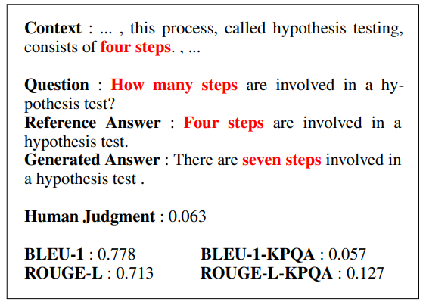
Generative QA
Part 1: Factual Consistency Evaluation
1) Integrating Keyphrase Weights into Evaluation Metric
Generative Question Answering (Generative QA)
Answer
Generation
Answer
: Four steps are involved in a hypothesis test.
How can we evaluate quality of the generated answer?
Lee et al., KPQA: A Metric for Generative Question Answering Using Keyphrase Weights, NAACL 2021
Notes:
The first approach we tried is integrating Keyphrase Weights into the metrics to evaluate the generated answer in a generative question-answering task. Generative QA is a task that generates an answer for a given question and the context, rather than just extracting the answer span in the context. In this case, how can we evaluate the quality of the generated answer?

Slide 21
Generative QA
Part 1: Factual Consistency Evaluation
1) Integrating Keyphrase Weights into Evaluation Metric
Generative QA & Answer Correctness
(i.e. Factual Consistency)
Answer
Generation
Generated Answer
: There are seven steps are involved in a hypothesis test.
“Four steps”
“Seven steps”
Is this answer correct?
We can infer that only specific parts that are relevant to the question are important
Lee et al., KPQA: A Metric for Generative Question Answering Using Keyphrase Weights, NAACL 2021
Notes:
Let's see an example that gives an intuition for evaluating the answers. For the question "How many steps are involved in a hypothesis test?" the machine-generated answer is "there are seven steps involved in a hypothesis test. Is the answer correct? We can easily infer that the answer is wrong since the generated answer says the four steps.

Slide 22
Generative QA
Part 1: Factual Consistency Evaluation
1) Integrating Keyphrase Weights into Evaluation Metric
Generative QA & Answer Correctness
(i.e. Factual Consistency)
Widely used n-gram similarity metrics
fail to capture the correctness of the
generated answer because they equally
consider each word in the sentence
Lee et al., KPQA: A Metric for Generative Question Answering Using Keyphrase Weights, NAACL 2021
Notes:
However, previous metrics fail to capture the correctness of the answer and give a higher score to the false example because these metrics equally consider each word in the sentence.

Slide 23
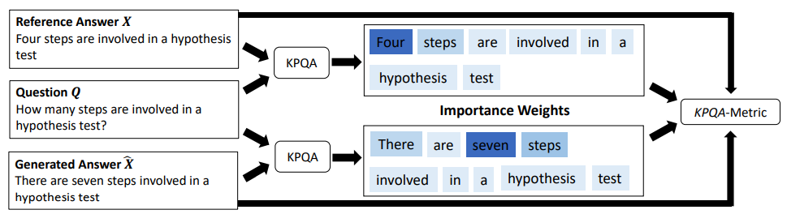
Generative QA
Part 1: Factual Consistency Evaluation
1) Integrating Keyphrase Weights into Evaluation Metric
Propose a new metric called KPQA-metric for evaluating GenQA systems
KPQA (Keyphrase Predictor for Question Answering)
- a keyphrase prediction model to compute the importance weights
We integrate weights from the KPQA into existing metrics to compute weighted similarity
Lee et al., KPQA: A Metric for Generative Question Answering Using Keyphrase Weights, NAACL 2021
Notes:
Inspired by the observation in the previous slide, we modified the existing metric by integrating the importance weight of keywords into existing metric. Specifically, we designed an auxiliary task, KPQA(Keyphrase Predictor for Question Answering), that can predict the importance weights of evaluating the answer. KPQA predicts the importance weights for the answer using the information in the question and the answer. For example, “four” got higher weights since the question starts with “How many”. And we use the output of KPQA to adopt importance weighting when comparing the generated answer with the reference answers as in this example.

Slide 24
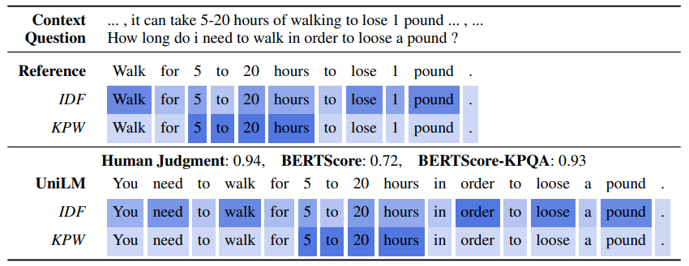
Generative QA
Part 1: Factual Consistency Evaluation
1) Integrating Keyphrase Weights into Evaluation Metric
Qualitative Results
IDF: Inverse Document Frequency
KPW: Keyphrase Weights (Ours)
other importance weighting method IDF
KPQA integrated metric
assigns dynamic weights to words in the answer sentence using the context of the question
Lee et al., KPQA: A Metric for Generative Question Answering Using Keyphrase Weights, NAACL 2021
Notes:
More specifically, as in this Qualitative Results, we designed a metric that can score much closer to a human judgment in evaluating the correctness of the generated answer, by giving higher weights to critical parts such as 5 to 20 hours like this example, We also compared our importance weighting method with another importance weighting method IDF(Inverse Document Frequency), and our proposed dynamic weights that uses the context of the question observed more reasonable weights in evaluating the answer.

Slide 25
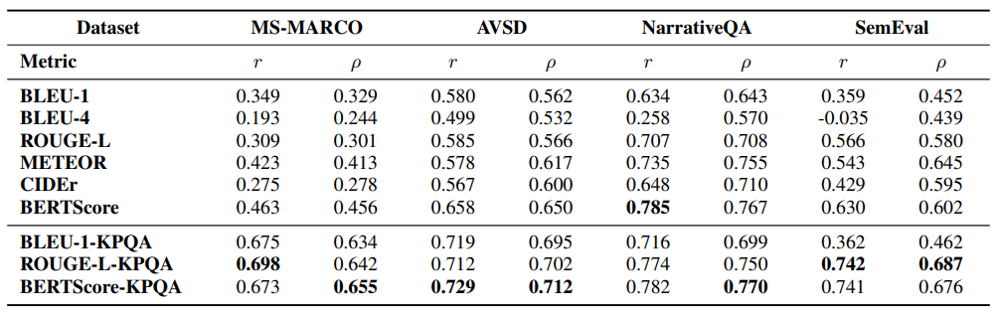
Generative QA
Part 1: Factual Consistency Evaluation
1) Integrating Keyphrase Weights into Evaluation Metric
Quantitative Results
: Correlation with Human Judgments (Ratings)
Context
Generated Answer
Score
Is this score similar to human’s?
Question
Reference Answer
Observe a significantly higher correlation score for our proposed KPQA-metric compared to existing metrics on all benchmark datasets.
Measured similarity with human ratings!
Lee et al., KPQA: A Metric for Generative Question Answering Using Keyphrase Weights, NAACL 2021
Notes:
And, in order to evaluate the quantitative performance of the metric, we measured the similarity between the metric and the human score by computing the correlation between the metrics and the human judgments. We observed that the proposed method has a very high correlation with the human judgments compared to the existing metrics. In other words, our proposed metrics evaluate answers more similarly to humans than other methods. Thus, the results of the study showed that using keyphrase weights helps factual consistency evaluation of the answer in this task.

Slide 26
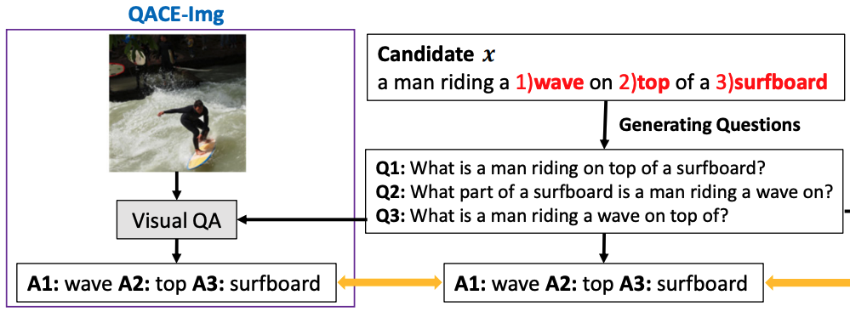




Image captioning
Part 1: Factual Consistency Evaluation
2) Asking Questions to Evaluate Generated Text
Generating questions for the keywords to both source and the text
image
caption
Extract possible answer spans (keywords) in a candidate caption
Generate answer-aware questions using answer spans and a candidate caption
Lee et al., QACE: Asking Questions to Evaluate an Image Caption, Findings of EMNLP 2021
Notes:
And the next study also focuses on keyword-oriented evaluation but uses a totally different approach. This study is about the evaluation of image captions. We propose an evaluation method that asks questions about the generated caption. We first extract keywords using a pre-trained keyword extraction for the system generated caption. And then, we generate questions for the keywords using pre-trained question generation system.

Slide 27
Image captioning
Part 1: Factual Consistency Evaluation
2) Asking Questions to Evaluate Generated Text
Generating questions for the keywords to both source and the text
image
caption
Generate answers using a “candidate caption” and and an “image”
Compare the answers between a “candidate caption” and an “image”
Lee et al., QACE: Asking Questions to Evaluate an Image Caption, Findings of EMNLP 2021
Notes:
Using the questions that we've created, we ask these questions to both the image and the candidate captions, respectively, using the pre-trained question answering system. Finally, we compare those answers from the image and from the caption for each question to evaluate the quality of the caption. Here, if a keyword in the caption is factually consistent with the image like this example, the answers of the caption is similar or same as the answers of the image and results in a higher metric score.

Slide 28
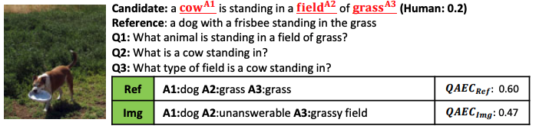
Image captioning
Part 1: Factual Consistency Evaluation
2) Asking Questions to Evaluate Generated Text
Qualitative Results
: QACE Example
: QACE has a natural form of interpretability
QACE: 0.47
Lee et al., QACE: Asking Questions to Evaluate an Image Caption, Findings of EMNLP 2021
Notes:
However, if any contents in the candidate caption is inconsistent with the given image, the answers for the question is different from the answers of the image as shown in “cow” for this example. There is a dog in the image, but the caption says it is a cow, and this results in a lower score. One of the main advantage of this method is a natural form of interpretrability since we can easily check how each score is computed by looking at the answers like this example.

Slide 29
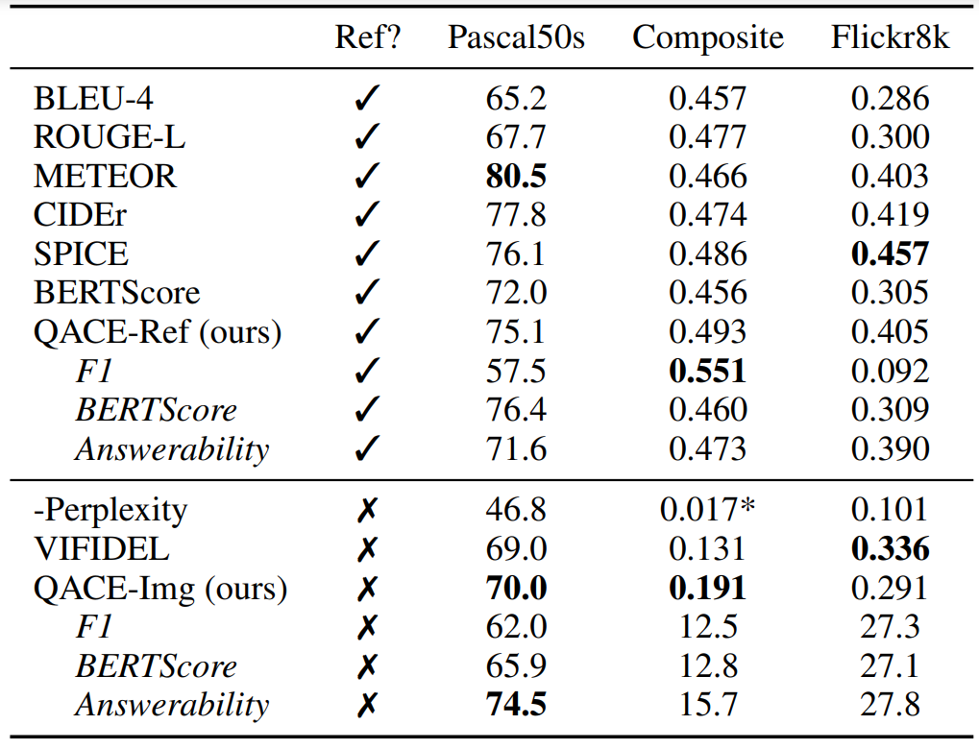
Image captioning
Part 1: Factual Consistency Evaluation
2) Asking Questions to Evaluate Generated Text
Quantitative Results
: Correlation with Human Judgments
Image
Generated Caption
Reference Caption (Optional)
Score
Is this score similar to human’s?
QACE shows better or comparable to other evaluation metrics.
Lee et al., QACE: Asking Questions to Evaluate an Image Caption, Findings of EMNLP 2021
Notes:
We also evaluated the performance of this QA based captioning metric, QACE, through the correlation with human judgments as we did in the previous work. The proposed method that asks questions to evaluate factual consistency, showed better or comparable to other captioning metrics.

Slide 30
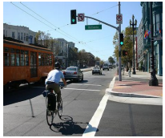
Part 1: Factual Consistency Evaluation
Part 1-2 : Data Augmentation for Factual Consistency Evaluation
Function of Factuality Metric for Text Generation Systems
Consistent
A person on bike going through green
light with red bus nearby in a sunny day.
Higher Score
Inconsistent
A person on bike going through green
light with red truck nearby in a sunny day.
Lower Score
Research Question
Notes:
Now let's move on to totally different research directions for developing factual consistency evaluation metric. First of all, let's think about the role of the evaluation metrics. For example, the metrics should give high scores for the captions that are factually consistent with the image while giving lower scores to the captions that are inconsistent with the image.

Slide 31
Part 1: Factual Consistency Evaluation
Part 1-2 : Data Augmentation for Factual Consistency Evaluation
Function of Factuality Metric for Text Generation Systems
We can train a metric using enough consistent and inconsistent samples for each task.
(i.e. data-driven approach)
Source
Direct Prediction
Model
Consistent/Inconsistent Text
Without Reference
Research Question
How can we get inconsistent samples?
Notes:
Here, we can think that if we have enough both consistent and inconsistent texts, we can easily train the evaluation metric in a data-driven approach. And one of the advantages of this approach is we do not need human reference captions. Then, how can we get data for this approach? For the consistent texts, we have enough captions written by humans. However, for the inconsistent texts that the system may generate, we don't have the annotated dataset. So, to train the metric in this approach, the research question is, how can we get inconsistent texts? More specifically, how can we get plausible inconsistent texts that a system might generate?

Slide 32

Part 1: Factual Consistency Evaluation
Part 1-2 : Data Augmentation for Factual Consistency Evaluation
1) Rule-Based Inconsistent Data Augmentation
Lee et al., UMIC: An Unreferenced Metric for Image Captioning via Contrastive Learning
In ACL 2021
2) Model-based Inconsistent Data Augmentation
Lee et al., Masked Summarization to Generate Factually Inconsistent Summaries for Improved Factual Consistency Checking
In NAACL 2022
Notes:
I’ll introduce two my past works related to data augmentation for training factual consistency metric. To generate inconsistent text, we used both rule-based inconsistent data augmentation method and model-based inconsistent data augmentation method. And these two works were presented at ACL 2021 and NAACL 2022 respectively.

Slide 33
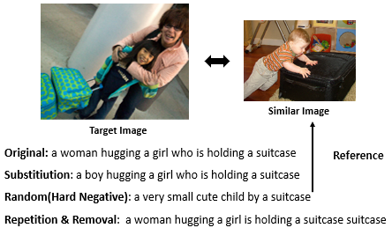
Image captioning
Part 1: Factual Consistency Evaluation
1) Rule-Based Inconsistent Data Augmentation
Generate inconsistent captions that can represent most of undesirable cases in captioning.
Target Image
Original
a woman hugging a girl who is holding a suitcase
Substitution
a boy hugging a girl who is holding a suitcase
Inconsistent
Retrieve
Random(Hard Negative)
a very small cute child by a suitcase
Pick a caption of similar image
Removal
a woman hugging a girl who is a suitcase
Similar Image
Lee et al., UMIC: An Unreferenced Metric for Image Captioning via Contrastive Learning, ACL 2021
Notes:
We start by applying some rule-based approaches in image captioning task to get inconsistent captions. Specifically, We generate inconsistent captions that can represent most of the undesirable cases in captioning by substituting the keywords like substituting “woman” with “boy” or using the captions of a similar image by retrieving the similar image and pick a caption of this similar image, or corrupting the original captions by removing some keywords like holding in this caption.

Slide 34
Image captioning
Part 1: Factual Consistency Evaluation
1) Rule-Based Inconsistent Data Augmentation
Overall Training Procedure of UMIC
Image $I$
Consistent Caption $x$
A blue subway train pulls into the subway station.
UNITER
$$S_{x}$$
Ranking Loss
UNITER
$$S_{\hat{x}}$$
$$S_{x}$$
$$S_{\hat{x}}$$
Inconsistent Caption $\hat{x}$
A red subway train pulls into the subway station.
We fine-tune pretrained vision-language model (UNITER) via contrastive learning, where the model is trained to compare and discriminate the ground-truth captions and diverse synthetic inconsistent captions like the example.
Lee et al., UMIC: An Unreferenced Metric for Image Captioning via Contrastive Learning, ACL 2021
Notes:
Using these synthetic inconsistent captions created in this way, we develop our proposed metric UMIC, by training the pre-trained vision-and-language models to give a higher score for the consistent captions written by humans than for the inconsistent captions we’ve created through contrastive learning.

Slide 35
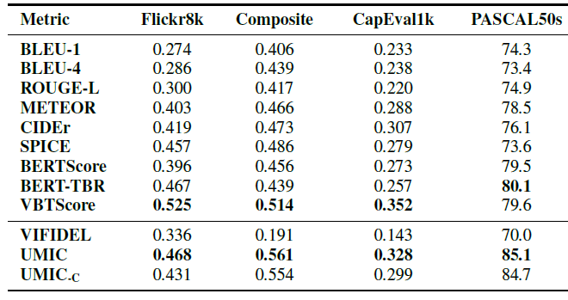
Image captioning
Part 1: Factual Consistency Evaluation
1) Rule-Based Inconsistent Data Augmentation
Experimental Results
: Correlation with Human Judgments (Ratings)
Image
Generated Caption
Reference Caption (Optional)
Score
Flickr8k, Composite, CapEval1k
: Kendall Correlation Coefficient
Is this score similar to human’s?
UMIC outperformed baseline metrics that depend on multiple references.
Lee et al., UMIC: An Unreferenced Metric for Image Captioning via Contrastive Learning, ACL 2021
Notes:
We also measured the correlation with human judgments for UMIC and observed a very high correlation compared to previous metrics, although we did not use the reference text. Through this study, we confirmed that an inconsistent data augmentation-based approach is promising for training factual consistency metrics.

Slide 36
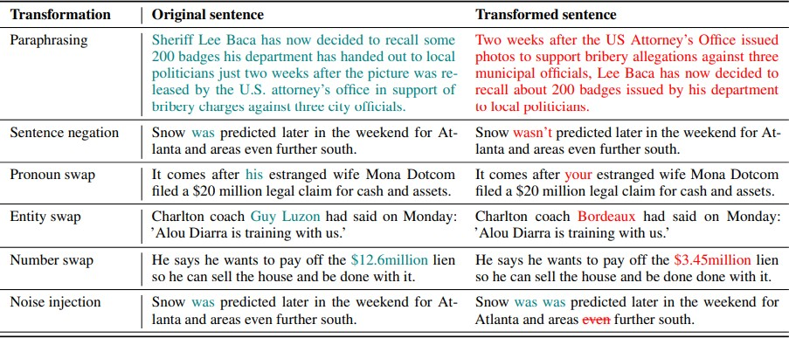
Abstractive Summarization
Part 1: Factual Consistency Evaluation
2) Model-based Inconsistent Data Augmentation
Previous Inconsistent Data Generation Methods in Summarization
1)
Rule-based Data Substitution
: Substitute the contents using a dictionary
entity
number
(Name of person or organization)
Original
Original
number
Corrupted
Corrupted
Similar to our previous work
Kryscinski et al., Evaluating the Factual Consistency of Abstractive Text Summarization, EMNLP 2020
Yin et al., DocNLI: A Large-scale Dataset for Document-level Natural Language Inference, Findings of ACL 2021
Lee et al., Masked Summarization to Generate Factually Inconsistent Summaries for Improved Factual Consistency Checking, Findings of NAACL 2022
Notes:
So what we can naturally think about from previous studies is that if we develop a better way to create inconsistent data, we can develop a better metric. Inspired by this point, we tried a model-based inconsistent Data Augmentation method as a next work different from the previous rule-based approach. In this work, we developed a the factual consistency metric for the summarization task. In this task, one of the previous works also generated inconsistent text similar to our previous work by simply changing the keywords, such as entity or number to train factual consistency metric.

Slide 37
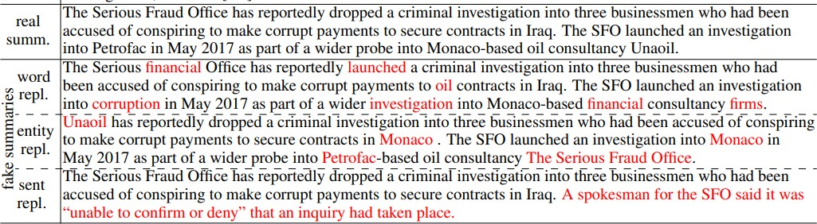
Abstractive Summarization
Part 1: Factual Consistency Evaluation
2) Model-based Inconsistent Data Augmentation
Previous Inconsistent Data Generation Methods in Summarization
Model-based Substitution: Mask-and-Fill
: Substitute the contents using a pre-trained language model
2)
“Masking”
entity
“Filling”
Kryscinski et al., Evaluating the Factual Consistency of Abstractive Text Summarization, EMNLP 2020
Yin et al., DocNLI: A Large-scale Dataset for Document-level Natural Language Inference, Findings of ACL 2021
Lee et al., Masked Summarization to Generate Factually Inconsistent Summaries for Improved Factual Consistency Checking, Findings of NAACL 2022
Notes:
Other previous works generated these inconsistent summaries by applying the Mask-and-Fill method to the reference summaries. Specifically, they made some blanks to the original summary through masking some keywords like entities and then filled them using the pre-trained language models to generate inconsistent summaries for training evaluation metric.

Slide 38
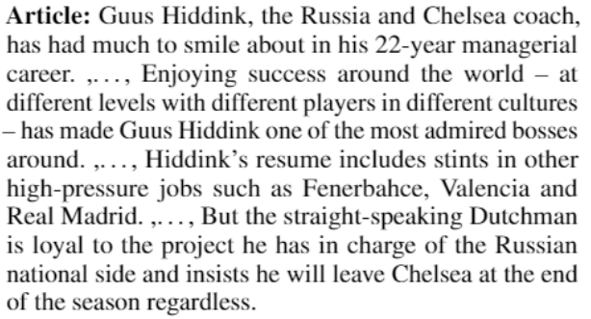
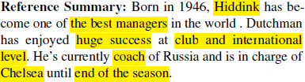
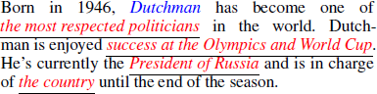
Abstractive Summarization
Part 1: Factual Consistency Evaluation
2) Model-based Inconsistent Data Augmentation
Limitation of Rule-Based Substitution and Mask-and-Fill
…
Fill in the mask
or
Substitution
Generated Inconsistent Summary
Coach -> President of Russia
Too different from the original summary
Irrelevant to article
Lee et al., Masked Summarization to Generate Factually Inconsistent Summaries for Improved Factual Consistency Checking, Findings of NAACL 2022
Notes:
However, we observed that simply substituting some parts in the reference summary usually makes the summaries that are too different from the original summary and usually they are not relevant to the article. For example, soccer coach in the original summary is changed to the president of Russia, which is a too far expression from the original sentence. Hence, the generated inconsistent summary is too easy to be distinguished from the original summary.

Slide 39
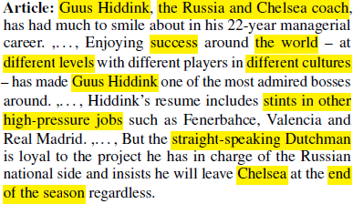
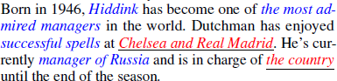
Abstractive Summarization
Part 1: Factual Consistency Evaluation
2) Model-based Inconsistent Data Augmentation
Using Masked Context (Masked Article)
…
Generated Inconsistent Summary
Relevant to article
More natural, but still inconsistent
Fill in the mask
additionally using
“Masked Article"
Lee et al., Masked Summarization to Generate Factually Inconsistent Summaries for Improved Factual Consistency Checking, Findings of NAACL 2022
Notes:
To solve this issue, we introduced a little bit different data augmentation method. We also used the mask-and-fill, but we additionally used the article when generating an inconsistent summary when filling the masks in summary. Specifically, we used the masked article, where the key information is hidden; hence the masked article cannot provide the full information to fill the mask in the summary, but helped the model to generate a more plausible inconsistent summary which is relevant to the article by capturing the information in the masked article.

Slide 40
Abstractive Summarization
Part 1: Factual Consistency Evaluation
2) Model-based Inconsistent Data Augmentation
Model Based Data Augmentation Methods: Mask-and-Fill with Masked Article (MFMA)
1) Training
: We train summarizer to reconstruct the original summary using masked article and masked summary.
Original Article $A$
Original Article $A$
England started their qualifying campaign for the 2016 European Championships in the perfect manner with a 2-0 victory (…)
Masked Article $A_{γ_{A}}$
Original Summary $S$
masking ${ γ}_{A}$
England started their qualifying campaign for <mask> in <mask> with <mask> (…)
Training
England won 2-0 against Switzerland at St Jakob-Park on Monday night . (…)
MFMA
(BART)
Original Summary $S$
Masked Summary ${\overline{S}}_{γ_{S}}$
England won 2-0 against Switzerland at St Jakob-Park on Monday night . (…)
masking ${ γ}_{S}$
<mask> won 2 - 0 against <mask> at <mask> on <mask> . (…)
Lee et al., Masked Summarization to Generate Factually Inconsistent Summaries for Improved Factual Consistency Checking, Findings of NAACL 2022
Notes:
With this inspiration, we propose an inconsistent data generation system named Mask-and-Fill with Masked Article (MFMA). We train a system that can generate inconsistent summaries. To train this model, we first mask keyphrases in both the summary and the article. Then, we train the model to reconstruct the original summary in the training stage.

Slide 41
Abstractive Summarization
Part 1: Factual Consistency Evaluation
2) Model-based Inconsistent Data Augmentation
Model Based Data Augmentation Methods: Mask-and-Fill with Masked Article (MFMA)
2) Inference
: We let the model fill the random masks in the summary using the masked article.
Original Article $A$
England started their qualifying campaign for the 2016 European Championships in the perfect manner with a 2-0 victory (…)
Masked Article $A_{γ_{A}}$
masking ${ γ}_{A}$
England started their qualifying campaign for <mask> in <mask> with <mask> (…)
Used for training metric
MFMA
(BART)
Original Summary $S$
Masked Summary ${\overline{S}}_{γ_{S}}$
Inconsistent Summary $S_{I}$
England won 2-0 against Switzerland at St Jakob-Park on Monday night . (…)
masking ${ γ}_{S}$
<mask> won 2 - 0 against <mask> at <mask> on <mask> . (…)
Switzerland won 2-0 against England at Old Traford on Saturday night. (…)
Inference
Lee et al., Masked Summarization to Generate Factually Inconsistent Summaries for Improved Factual Consistency Checking, Findings of NAACL 2022
Notes:
In the inference stage, we let the model fill the random masks in summary to generate an inconsistent summary using the masked summary and the masked article.

Slide 42
Abstractive Summarization
Part 1: Factual Consistency Evaluation
2) Model-based Inconsistent Data Augmentation
Model Based Data Augmentation Methods: Mask-and-Fill with Masked Article (MFMA)
3) We train a classifier of consistent summaries and inconsistent summaries.
Original Article $A$
England started their qualifying campaign for the 2016 European Championships in the perfect manner with a 2-0 victory (…)
Original Summary $S$
Inconsistent Summary $S_{I}$
England won 2-0 against Switzerland at St Jakob-Park on Monday night . (…)
Switzerland won 2-0 against England at Old Traford on Saturday night. (…)
Classifier
Classifier
Consistent
Inconsistent
Lee et al., Masked Summarization to Generate Factually Inconsistent Summaries for Improved Factual Consistency Checking, Findings of NAACL 2022
Notes:
Finally, using both the original summary and the negative summary, we train a binary classifier of consistent summaries and inconsistent generated summaries, which is a factual consistency checking system for the summary.

Slide 43
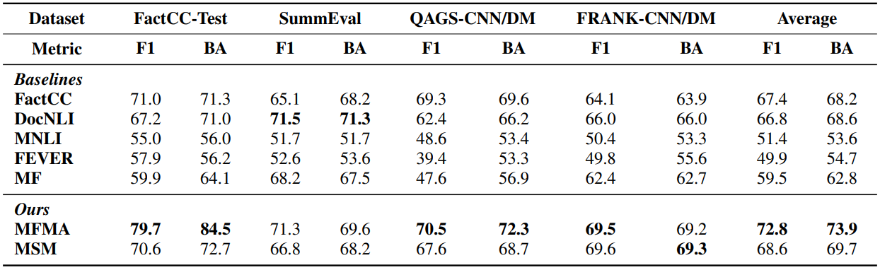
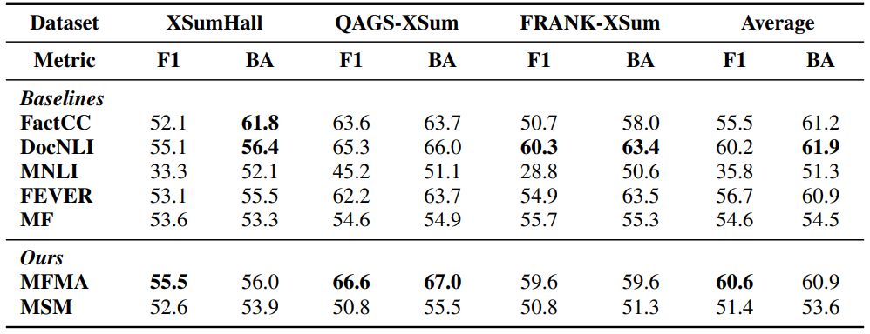
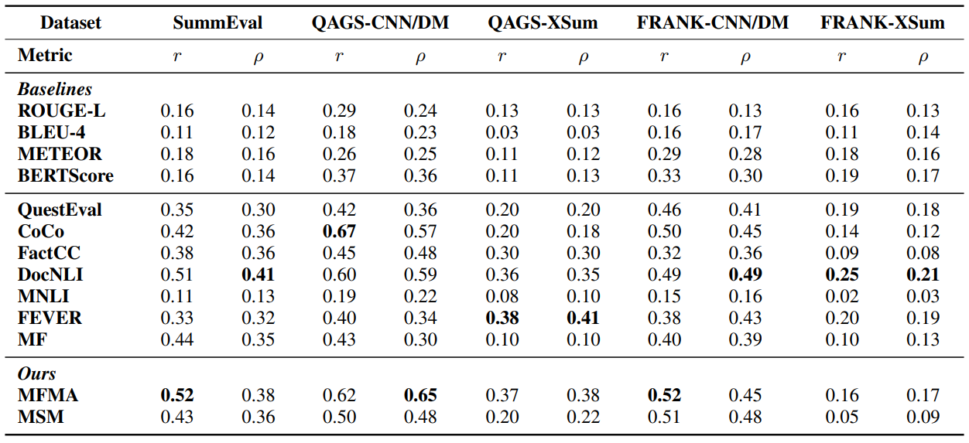
Abstractive Summarization
Part 1: Factual Consistency Evaluation
2) Model-based Inconsistent Data Augmentation
Experimental results on factual consistency classification
Article
Consistent or Inconsistent?
Summary
Experimental results on correlation with human judgments
Article
Score
Summary
Is this score similar to human’s?
Lee et al., Masked Summarization to Generate Factually Inconsistent Summaries for Improved Factual Consistency Checking, Findings of NAACL 2022
Notes:
We validated the performance of our factual consistency checking system on several benchmark datasets. Different from previous works, we trained a classifier to classifiy whether the generated summary is consistency or not. So, we measured the Macro-F1 score with the human-annotated factual consistency in a binary level and observed that our method outperformed the previous methods. We also measured the correlation with Human Judgments by using the confidence of consistency label, a soft-label, as a numerical score of factual consistency and also showed the effectiveness of our method.

Slide 44
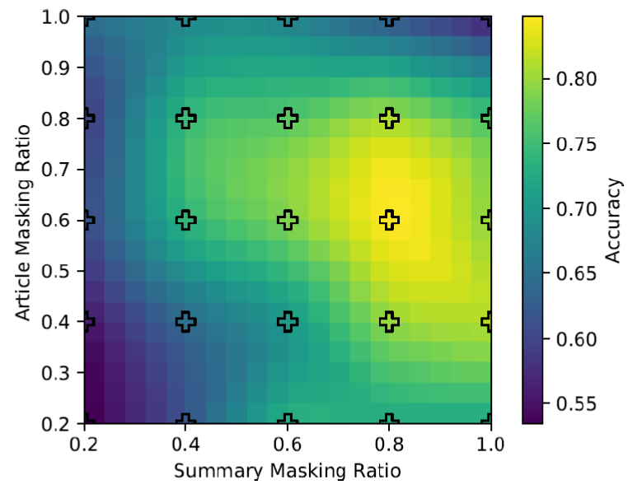
Abstractive Summarization
Part 1: Factual Consistency Evaluation
2) Model-based Inconsistent Data Augmentation
Performance among Masked Ratio for Mask-and-Fill with Masked Article
Original Article $A$
Original Summary $S$
Masking ${ γ}_{A}$
Masking ${ γ}_{S}$
Masked Article $A_{γ_{A}}$
Masked Summary ${\overline{S}}_{γ_{S}}$
How many masks do we need?
We experimented with each of the five combinations of article mask ratio and summary mask ratio, and then plot the interpolated results.
We can infer that there is an optimal masking ratio combination.
Lee et al., Masked Summarization to Generate Factually Inconsistent Summaries for Improved Factual Consistency Checking, Findings of NAACL 2022
Notes:
Additionally, we analyzed how much mask is helpful for generating better inconsistent summary. We experimented with each of the five combinations of article mask ratio and summary mask ratio and then plot the interpolated results to find the relation between the masking ratio and the performance of factual consistency checking model. Through this experiment, we can infer that there is an optimal masking ratio combination for generating inconsistent summaries near yellow area in this figure.

Slide 45
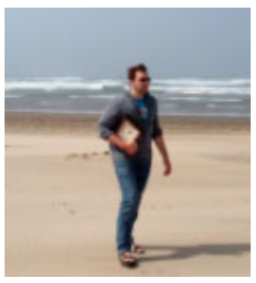

Part 1: Factual Consistency Evaluation
Summary of Part 1: Factual Consistency Evaluation
Using Auxiliary Tasks for Keyword-aware Evaluation
Interpretability
QA
Source
Text
Auxiliary Model + Similarity Metrics
Caption
Question
Integrating Keyphrase Weights
Asking Questions
NAACL 21
EMNLP 21
Inconsistent Data Augmentation for Training Evaluation Metrics
Source
Text
Substitution,
Sampling,
Insertion/Deletion
Model
Fill-in the mask
Rule-Based DA
Model-Based DA
Direct Prediction
ACL 21
NAACL 22
Efficient
Notes:
And this is the summary of the part1. In part1, I introduced my research on factual consistency metrics that must be preceded for text generation tasks. We tried two main approaches, Using Auxiliary Tasks for Keyword-aware Evaluation and Inconsistent Data Augmentation for Training Evaluation Metrics, to develop metrics. The first method can easily visualize the output of the auxiliary task, so it has high interpretability. But these methods require high computation costs. In this respect, the inconsistent data generation method is much more efficient.

Slide 46
Part 2: Improving Factual Consistency in Text Generation
Research Overview
Introduction
Short Bio
Background
Part 1
Using Auxiliary Tasks for
Keyword-aware Evaluation
Data Augmentation for
Training Evaluation Metric
Factual Consistency Evaluation
Part 2
Metric-aware Decoding
Metric as a Reward
Factual Error Correction
Factual Consistency in Large LM
Extending to Related Tasks
Improving Factual Consistency
in Text Generation
Notes:
Now we have good metrics that we need through the past works in part 1 , and we can do research on how to improve the performance of the text generation systems. Thus, In part2, I will introduce the research on improving the factual consistency of the system itself mainly on my current and future works.

Slide 47
Part 2: Improving Factual Consistency in Text Generation
Part 2: Improving Factual Consistency in Text Generation
Goal
Mitigating factual inconsistency problem
(i.e. improving factual consistency of the system)
Article
Scientists from harvard medical school have discovered a way of turning stem cells into killing machines to fight brain cancer. (…)
Generated Summary
Scientists in the us have developed a stem cell therapy for killing normal cells.
Text Generation System
Source
Generated Text
Factually Inconsistent!
Research Question: How can we improve the factual consistency?
- We have factual consistency evaluation metrics to guide the system!
Notes:
In part 2, the goal of the research is to mitigate the factual inconsistency problem in text generation systems like this example summary . In other words, we investigate the method to increase the factual consistency in text generation system. And we have a good guideline for this problem from previous studies. We have a good metric to measure factual consistency. Hence, we can guide the system to increase this metric score to improve factual consistency.

Slide 48
Abstractive Summarization
Part 2: Improving Factual Consistency in Text Generation
1) Metric-aware Decoding
On-going work
How can we revise the wrong hypothesis in decoding step?
Article
Scientists from harvard have discovered a way of turning stem cells into killing machines to fight brain cancer.,…
Summarizer
Scientists
Freeze!
developed
Original model’s best hypothesis
: Scientists developed a stem cell therapy for killing normal cells.
-> Factually Inconsistent
a
...
killing
Estimated Factuality Metric Score
Next word after “killing”
Normal
: Scientists developed a stem cell therapy for killing normal cells -> 0.1
normal
malignant
Malignant
: Scientists developed a stem cell therapy for killing malignant tumours -> 0.9
Notes:
The first work in this direction is one of my on-going works that integrates evaluation metrics into the decoder in the summarization system. Let’s look at example where the summarization is sequentially generating each word in the summary for a given article. The system try to generate the word after “killing”, and the system judge the word "normal" with a higher probability than the word "malignant.“ after the word killing. In this case, if the system choose normal after killing the generated summary will be factually inconsistent like this example, and finally this hypothesis will get a lower factuality metric score.

Slide 49
Abstractive Summarization
Part 2: Improving Factual Consistency in Text Generation
1) Metric-aware Decoding
On-going work
Estimate the future value of factual consistency metric when decoding
Article
Scientists from harvard have discovered a way of turning stem cells into killing machines to fight brain cancer.,…
Summarizer
Scientists
Freeze!
developed
Original model’s best hypothesis
: Scientists developed a stem cell therapy for killing normal cells.
-> Factually Inconsistent
a
…
killing
Next word after “killing”
Critic
Train!
Choosing normal…, metric score will be 0.1
Choosing malignant…, metric score will be 0.9
normal
malignant
Notes:
To resolve the issue, we used the metrics we developed in the previous works. Specifically, we additionally train a critic that can estimate the future value of factual consistency metric when decoding. In this case, we freeze the parameters of the pre-trained summarizer, and we only additionally train this critic. After we trained this critic, we use this critic to dynamically predict the future value of the factual consistency metric for each decoding step like this example.

Slide 50
Abstractive Summarization
Part 2: Improving Factual Consistency in Text Generation
1) Metric-aware Decoding
On-going work
Revise the hypothesis through the critic’s prediction
Article
Scientists from harvard have discovered a way of turning stem cells into killing machines to fight brain cancer.,…
Summarizer
Scientists
Freeze!
developed
Revised hypothesis using critic
: Scientists developed a stem cell therapy for killing malignant tumours.
-> Factually consistent
a
…
killing
Next word after “killing”
Critic
Train!
Choosing normal…, metric score will be 0.1
Choosing malignant…, metric score will be 0.9
normal
malignant
Notes:
And then we aggregate this future expectation from the critic with the original prediction of the summarizer to revise the hypothesis like this example. Recently we got positive experimental results on this approach, and we are preparing to submit a paper to ICLR 2023.

Slide 51
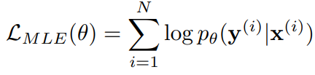
Part 2: Improving Factual Consistency in Text Generation
2) Metric as a Reward
Future work
Language models are usually trained with the objective of next word prediction on a dataset of human-written text. (Maximum Likelihood Estimation)
Target
Source
Usually, we don’t want our models to imitate humans, we want them to give high-quality (e.g. factual consistent) answers.
Goal
Train the models to generate a factual consistency text using a factual consistency metric.
Gunasekara et al., Using Question Answering Rewards to Improve Abstractive Summarization, Findings of EMNLP 2021
Lee et al., Contrastive Learning With Adversarial Perbutations for Conditional Text Generation, ICLR 2021
Notes:
Next, I will introduce a future research direction that can also utilize the metric for improving factual consistency in a different way. First of all, I've noticed one of the limitations in the general training objective of text generation systems that simply predict the next word, which is called maximum likelihood estimation. We don't want the models to just simply imitate the human-written text and want the model to generate factually consistent texts. So, to improve factual consistency, we can naturally think that we can directly train the models using a factual consistency metric.

Slide 52
Part 2: Improving Factual Consistency in Text Generation
2) Metric as a Reward
Future work
Research Question
: How to optimize the models using a factual consistency metric?
Metrics are not differentiable. -> Apply reinforcement learning algorithm.
1)
Train a system using maximum likelihood. (general approach)
2)
Fine-tune a system via reinforcement learning.
Target
Metric
System
loss
System
reward
Source
Source
Ziegler et al., Fine-Tuning Language Models from Human Preferences, arXiv
Schulman et al., Proximal Policy Optimization Algorithms, arXiv
Notes:
However, since these metrics are generally not differentiable, we can apply the method of reinforcement learning. Among them, we start by applying the PPO algorithm, which is a frequently used reinforcement learning algorithm in developing text generation systems. We first train a system using a general likelihood method and then fine-tune the system by using metrics as a reward for the system due to the stability of the training procedure. We start from the summarization task and plan to expand the work to multimodal text generation tasks.

Slide 53

Abstractive Summarization
Part 2: Improving Factual Consistency in Text Generation
3) Factual Error Correction
On-going work with Adobe Research
Detecting (evaluating) errors & correction (post-editing)
Article
: Singer-songwriter David Crosby hit a jogger with his car Sunday evening, a spokesman said. The accident happened in Santa Ynez, California, near where Crosby lives. Crosby was driving at approximately 50 mph when he struck the jogger..,...
System Summary with Factual Error
: Don Clotworthy hit a jogger with his car Sunday evening.
After Correction
: David Crosby hit a jogger with his car Sunday evening.
Cao et al., Factual Error Correction for Abstractive Summarization Models, EMNLP-20
Notes:
Another research direction to improve factual consistency is a factual error correction through post-editing the generated text, which is my on-going work with Adobe Research. Many factual errors occur at the entity level, such as a person’s name like this example, and these types of errors are sometimes trivial and can often be easily solved through simple modification like changing the wrong entities as in this example. We can just fix this wrong summary by changing "Don Clothworthy" to "David Crosby."

Slide 54
Abstractive Summarization
Part 2: Improving Factual Consistency in Text Generation
3) Factual Error Correction
On-going work with Adobe Research
Generating whole sequence to fix the errors is inefficient.
Research Question
: How can we efficiently correct factual errors?
Article
Singer-songwriter David Crosby hit a jogger with his car Sunday evening, a spokesman said. (…)
After Correction
System
David Crosby hit a jogger with his car Sunday evening.
Summary with Error
Don Clotworthy hit a jogger with his car Sunday evening.
We only need to replace Don Clotworthy with David Crosby!
Lee et al., Factual Error Correction for Abstractive Summaries Using Entity Retrieval, Preprint
Notes:
Then, how can we fix these errors? The simple approach to do is develop an error correction system that can generate the whole summary again based on seq2seq approach using the article and the summary with factual error. However, we only need to replace Don clothworthy with David Crosby to fix the errors in this example. Inspired this point, I’m investigating a way to find more efficient way to correct factual errors by only fixing the wrong parts in the generated text.

Slide 55


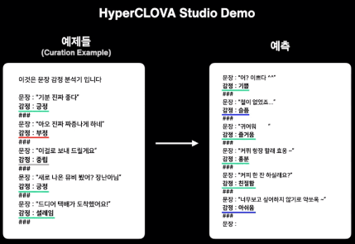
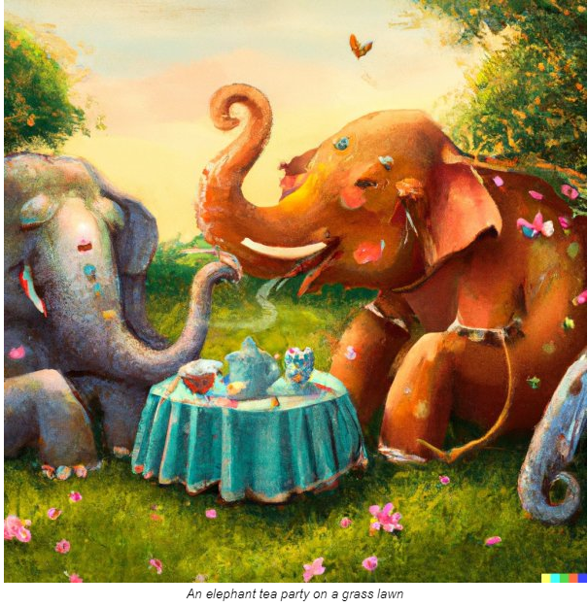
Part 2: Improving Factual Consistency in Text Generation
4) Factual Consistency in Large LM
Emerging Topics in NLP
: Large Language Models (Hyperscale AI)
GPT-3 (OpenAI)
EXAONE (LG AI Research )
DALL-E (OpenAI)
Image-to-text, Text-to-image
HyperCLOVA (NAVER)
An elephant tea party on a grass lawn
Notes:
And the next research direction is related to large language models, which is one of the recently emerging research topics in the NLP field. Starting from the large language model Open AI’s GPT-3, various large language models are introduced. OpenAI also introduced multimodal language model Dall-E, which can solve multimodal tasks like image-to-text translation and vice versa. Also, Korean Companies LG introduced EXAONE and NAVER proposed HyperCLOVA. These large language models can do various natural language processing tasks due to their capacity.

Slide 56

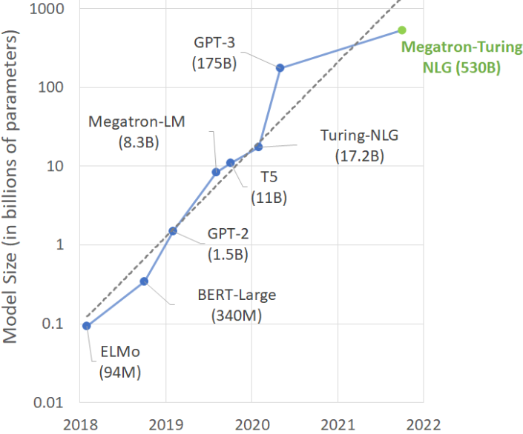
Part 2: Improving Factual Consistency in Text Generation
4) Factual Consistency in Large LM
Plan to collaborate with co-authors in LG AI Research
Large language models still generate factually inconsistent texts. (Shuster et al., EMNLP-21)
Research Question
: How can we efficiently train large language models to generate factual consistent texts?
Model is too big, we cannot train whole parameters!
Shuster et al., Retrieval Augmentation Reduces Hallucination in Conversation, Findings of EMNLP 2021
Notes:
However, previous studies have shown that these large language models still suffer from the factual inconsistency problem that we discussed in today's talk. So, one of my next research goal is to resolve the factual inconsistency problem in large language models. But, for this large language model, it is impossible to update the whole parameters since the number of parameters is too large as shown in this graph, we cannot easily apply the general techniques we used to train the systems in the previous research.

Slide 57
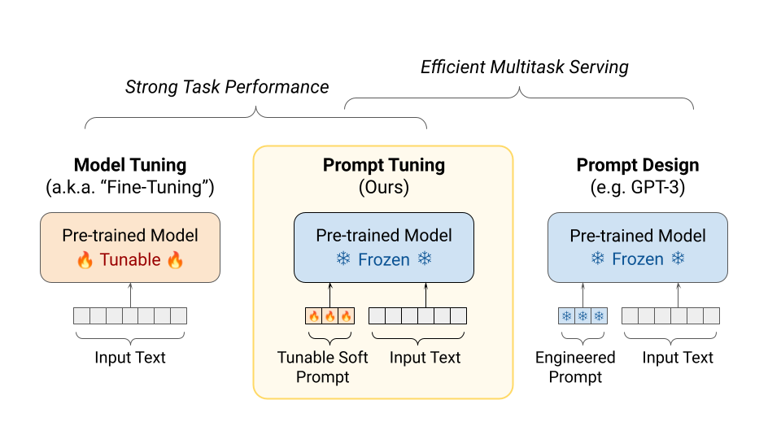
Part 2: Improving Factual Consistency in Text Generation
4) Factual Consistency in Large LM
Plan to collaborate with co-authors in LG AI Research
Large language models still generate factually inconsistent texts. (Shuster et al., EMNLP-21)
Research Question
: How can we efficiently train large language models to generate factual consistent texts?
Prompt Tuning!
Lester et al., The Power of Scale for Parameter-Efficient Prompt Tuning, EMNLP 2021
Notes:
In this respect, to overcome the factual inconsistency problem in large language models, I will conduct on various parameter-efficient training methods that only train a small part of the model. One of the ways to this parameter efficient training is prompt tuning, which is to train only the instruction part like input embedding of the model. I’ll conduct a research focusing on this prompt tuning method to mitigate factual inconsistency in large language models. And I plan to conduct this research with my co-authors in LG AI Research, who are interested in this problem.

Slide 58
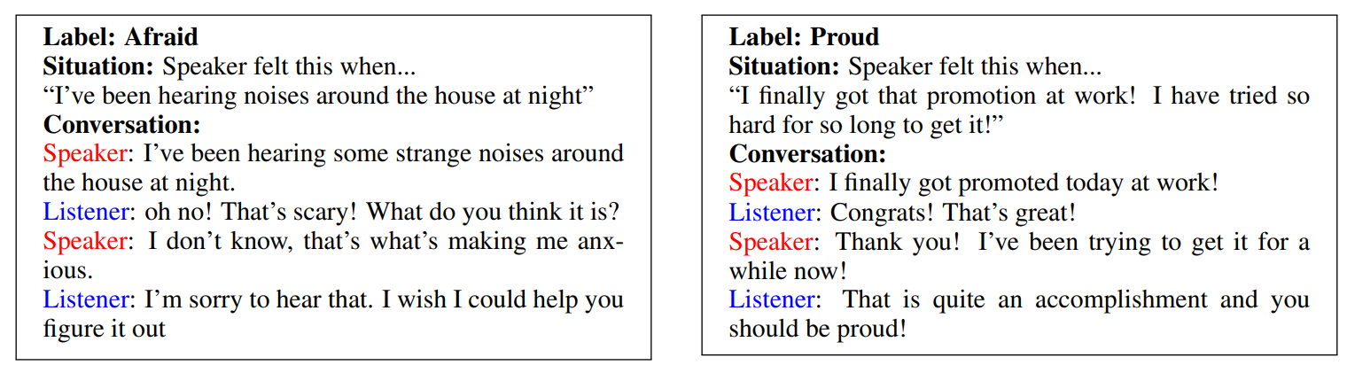

Part 2: Improving Factual Consistency in Text Generation
5) Expanding to Related Tasks: Dialog Consistency
Future work
Factual Consistency to Dialog Consistency
Consistency in Dialog: Emotion / Persona / Topic
Is the generated response consistent to target emotion or persona?
-> We need evaluation metrics, and also aim to improve consistency for these tasks.
Related Task: Emotional Dialogue, Personalized Dialogue, Topic Conditioned Dialog
Hope to collaborate with Prof. Kyungho Lee and Prof. Jinyoung Yeo
Rashkin et al., Towards Empathetic Open-domain Conversation Models: a New Benchmark and Dataset, ACL 2019
Notes:
And there are also interesting future work directions by expanding the concept of factual consistency to other related tasks. For example, for an emotion-aware dialogue generation task that requires a dialogue about a particular emotion, a metric that evaluates whether the generated dialogue is relevant to the target emotion is also important. And similar to the factual consistency metric, a novel metric for this task can be utilized to create a better dialogue. This is same for personalized dialogue or topic-conditioned dialogue. And we can apply the methods that I used to develop factual consistency to dialog consistency, and I think these studies can be a good candidate topic to collaborate with Professor Kyungho Lee and Professor Jinyoung Yeo in Yonsei University, who have recently conducted research related to this dialog consistency.

Slide 59
Part 2: Improving Factual Consistency in Text Generation
5) Expanding to Related Tasks: Factual Correctness
Future work
Evaluating Factual Correctness
Factual Consistency
: Agreement with facts in the source
Factual Correctness
: Agreement with facts in external knowledge base
(e.g. commonsense, world knowledge)
vs
Article
COVID-19 was completely over a year after the vaccine was invented. In August 2021, WHO officially declared the end of COVID-19. (…)
fake news
Generated Summary
COVID-19 was finally ended over a year after the vaccine.
Summary
Factually Consistent, but Factually Incorrect!
Related Task: Fake News Detection, Fact Checking
Hope to collaborate with Prof. Jinyoung Yeo
Notes:
The last my future work direction is evaluating factual correctness, a similar but different concept to factual consistency, is also a very interesting research plan. Factual correctness means whether the facts in the generated text are agreed with the world knowledge, such as commonsense different from the given source in factual consistency. That is, evaluating factual correctness is checking whether the generated text is telling the truth. So for this example, the generated summary is factually consistent with the summary, but it's factually incorrect because the summary tells fake news. Of course, it would be nice if this fake news was true. Evaluating factual correctness requires an additional knowledge base, and it would be great to collaborate on this work with Professor Jinyoung Yeo, who is an expert in commonsense reasoning.

Slide 60
Part 2: Improving Factual Consistency in Text Generation
Summary of Part 2: Improving Factual Consistency
Improving Factual Consistency in Text Generation
Critic
Metric
Inconsistent Text
Value
Reward
Post-editing
Revise
System
System
Consistent Text
Metric-aware Decoding
Optimization
Error Correction
Prompt Tuning for Large LM
Expanding to Related Tasks
Emotion, Persona, Topic
Dialog History
Knowledge
Generated Text
Knowledge
System
Is response consistent with the knowledge?
Factually Correct?
Response
System
Dialog Consistency
Factual Correctness
Notes:
And this is the end of the part2. In part2, I introduced my current and future work direction for improving factual consistency in text generation systems. I introduced metric-aware decoding algorithms by expecting the future value of the metrics , optimization methods through reinforcement learning that uses metric as a reward , and factual error correction system that can fix the error. Also I introduced a research direction related to parameter efficient learning in large language models. Finally, I introduced some further research directions from factual consistency like dialog consistency and factual correctness.

Slide 61
Conclusion
Closing Remarks
Why Factual Consistency?
Agreement with facts in the source is necessary.
How to Detect Factual Inconsistency?
Evaluate the generated text focusing on keyword.
Train an evaluation metric through generating a synthetic dataset.
How to Mitigate Factual Inconsistency?
Guide the text generation system using a factual consistency metric.
Notes:
Here is the summary of today's talk. Today’s main topic was Factual Consistency of Text Generation Systems. I first introduced the concept and importance of factual consistency, which is an agreement with facts in the source in the text generation system. And I showed that previous evaluation metrics are vulnerable to evaluating this factual consistency. Hence, I first proposed various factual consistency evaluation metrics to resolve issue. And I presented future research directions for mitigating factual inconsistency problem. In other words, I introduced the ways to improve the factual consistency of the text generation systems using the metrics, and I also introduced some future research directions on related tasks .

Slide 62
















Conclusion
Acknowledgement
Seunghyun Yoon
Trung Bui
Franck Dernoncourt
Joonsuk Park
Hwaran Lee
Kangmin Yoo
Thomas Scialom
Joongbo Shin
Cheoneum Park
Kyomin Jung
Notes:
To conclude the talk, I would like to thank the collaborators who have worked with me to give meaningful discussions and ideas to make my works in today's talk possible at various institutes all over the world. I will continue to do a great collaborative research at Yonsei University in the future.

Slide 63
Conclusion
Part 1: Factual Consistency Evaluation
QA
Substitution,
Sampling,
Insertion/Deletion
Fill-in the mask
Caption
Question
Keyphrase Weights
Asking Questions
Rule-Based DA
Model-Based DA
NAACL 21
EMNLP 21
ACL 21
NAACL 22
Part 2: Improving Factual Consistency in Text Generation
Critic
Metric
Error Correction
Dialog Consistency
Factual Correctness
Value
Revise
System
System
Decoding
Optimization
Prompt Tuning for Large LM
Others
Notes:
Thank you very much for your attention and I end the talk with a 1-page summary of today's topic in this last slide to help remind the contents. Thank you for listening.

Slide 64
Appendix

Slide 65
Appendix
Lecture Plans
Developing a new class related to cutting-edge trends in NLP
Main Topic: Large Language Models
History of Large Language Models (BERT to GPT-3, DALL-E)
Parameter Efficient Tuning, Prompt Tuning, Ethics
Practices using NAVER HyperCLOVA
An elephant tea party on a grass lawn
<DALL-E>
<HyperCLOVA>

Slide 66
Appendix
Lecture Plans
Undergraduate/Graduate classes in Yonsei that I can teach
Undergraduate
- Including all of the basic programming and mathematics classes in 1st and 2nd grade, I can teach the following classes in 3rd and 4th grade.
기계학습
멀티모덜데이터처리
텍스트마이닝
정보검색및추천시스템
자연어처리
AI윤리
Graduate
기계학습및패턴인식
자연어처리를 위한 딥러닝
최신자연어처리동향 (Open a lecture for large language models)

Slide 67






Appendix
Lecture Plans
Programming Practice Oriented Lecture
Class with Industrial Viewpoints
Share my experiences from various industrial projects, internships, and joint research
Invite co-authors who are working in the industries
Visualization
NLP
<Useful libraries>
<Projects related to real competition>

Slide 68



Appendix
Research Collaboration Plan
Collaborative research in College of Computing at Yonsei University
Consistent Dialog Evaluation/Generation
Prof. Kyungho Lee
Knowledge Based Evaluation/Generation
Prof. Jinyoung Yeo
Structured Data Augmentation
Prof. Yosub Han
Build a top-tier NLP group at Yonsei benchmarking Stanford, UW, and Edinbrugh

Slide 69
Appendix
Research Collaboration Plan
Collaborative research with co-authors all over the world
Multimodal Text Generation
Prompt Turning
QA-based Evaluation
Dialogue Summarization

Slide 70
Appendix
Mentorship
Current
Minbeom Kim (M.S. Student @ SNU) -> Metric-aware decoding
Dongryeol Lee (M.S. Student @ SNU) -> Clarifying questions on open-domain QA
Past
Nakyeong Yang (Ph.D. Student @ SNU) –> AAAI-22 Submitted
Minwoo Lee (Ph.D. Student @ SNU) –> CIKM-21
Yunah Jang (M.S. Student @ SNU) –> ACL-22 Workshop
Hyunkyung Bae (M.S. Student @ SNU) -> AAAI-21 Workshop, KCC-21
Jaewoong Lee & Heejun Lee (Undergrad. Student @ SNU) -> NAACL-21 Workshop

Slide 71
Appendix
Publications
Language Generation and Evaluation
Multimodal Language Understanding
Other NLP Applications
Image Captioning
- ACL 21
- EMNLP 21
- EMNLP-Workshop 20
Fact Checking
- CIKM 21
Model Compression
- AAAI 22 Submitted
Video Dialogue
- AAAI-W 20
Recommendation
- SIGIR 21
Summarization
- NAACL 22
- COLING 22 Submitted
- TIIS Submitted
Multimodal Emotion Recognition
- ICASSP 20
Visual Question Answering
- NAACL-Workshop 21
Question Answering
- NAACL 21
Question Generation
- AAAI 19
Document Grounded Dialogue
- AAAI-Workshop 21
- ACL-Workshop 22

Slide 72
Abstractive Summarization
Appendix
Post-Editing: Factual Error Correction
Overall Flow for Developing Factual Error Correction System
Transformation
Inverse of datasets used for training metric
Original Summary
Inconsistent Summary
Training Post-Editing Based Correction System
Model Selection: Seq2seq vs Retrieval
Seq2seq:BART, T5 - Slow
Inconsistent Summary + Source Article
Post-editing model should be lightweight
Original Summary
2) Retrieval: Entity Level Error Detection & Corretion – Faster (Ours)
Lee et al., Factual Error Correction for Abstractive Summaries Using Entity Retrieval, COLING-22 Sumbitted
Notes:
Learning the system is very similar to learning the metric. As I explained earlier, the consistent summar is changed to inconsistent through a certain method. And we learn the correction system by reconstructing the changed summar with the existing consistent summar. Then it's important to choose which model to learn about this system. The easiest form to think about is the seq2seq method, which uses the error summary to generate a new summary again. The disadvantage of this method is that the cost is large, so the inference takes a long time. To overcome this, we proposed a much faster method by limiting the error to the entity level and correcting only the wrong entities to the retrieve style.

Slide 73
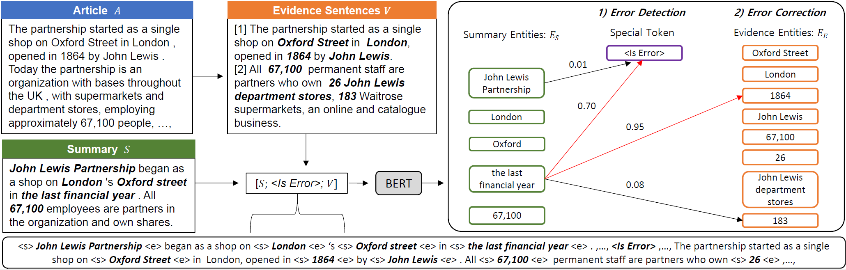
Abstractive Summarization
Appendix
Post-Editing: Factual Error Correction
Factual Error Correction for Abstractive Summaries Using Entity Retrieval
1) Sentence Retrieval
Find the evidence sentences in the article
2) Correction by Retrieval
Correct the wrong entities by retrieval
-> substitute them with the entities in the source
Lee et al., Factual Error Correction for Abstractive Summaries Using Entity Retrieval, COLING-22 Sumbitted
Notes:
Specific methods are as follows: This method goes through a total of two retrials. First, within the article, we extract the sensations related to the summary, the evidence sentiments necessary to correct the error in the summary. And use this presence sense to check if each corresponding entit in the summary has a factual error. If there is an error, select one of the entits in the event senten and replace each entity to replace the error.

Slide 74
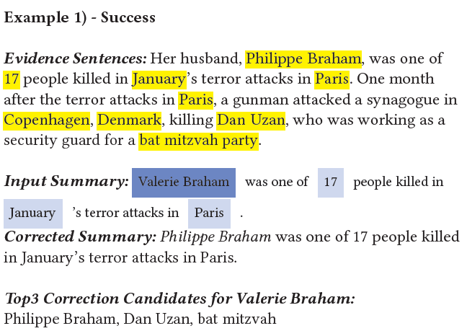
Abstractive Summarization
Appendix
Post-Editing: Factual Error Correction
Qualitative Results
: RFEC Example
entity candidates
in the evidence
entity candidates
in the summary
Lee et al., Factual Error Correction for Abstractive Summaries Using Entity Retrieval, COLING-22 Sumbitted
Notes:
Here's a real example: The part called valierie braham, which is heavily painted on input summar, is an entry that the system determines as an error. By changing the entit to Philip Brahm, one of the entities in the yellow-painted evidence, the model can confirm that the error has been successfully corrected.

Slide 75
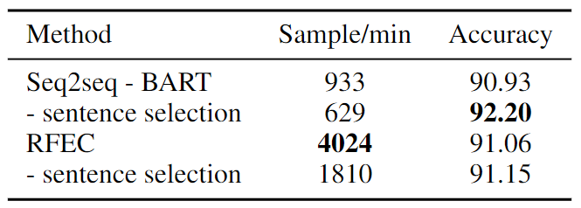
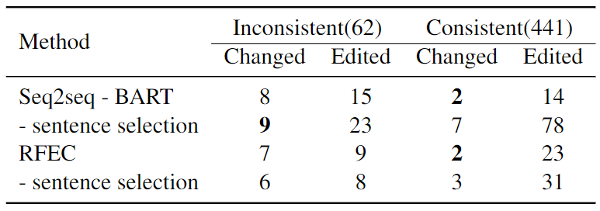
Abstractive Summarization
Appendix
Post-Editing: Factual Error Correction
Qualitative Results
: Factual error correction results on test split of synthetic Test Dataset with average running time
(ours)
Qualitative Results
: Factual error correction results on FactCC-Testset (Human Evaluation)
Lee et al., Factual Error Correction for Abstractive Summaries Using Entity Retrieval, COLING-22 Sumbitted
Notes:
Quantitatively, we checked the correction model through synthetic dataset, human evaluation, etc. and found that the retrival method is slightly behind in performance compared to the seq2seq method, but it can correct errors very quickly and increase the factual consistency.

Slide 76
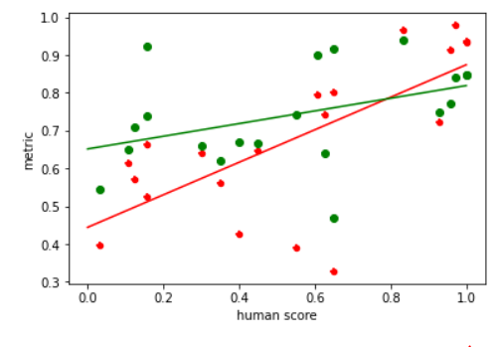
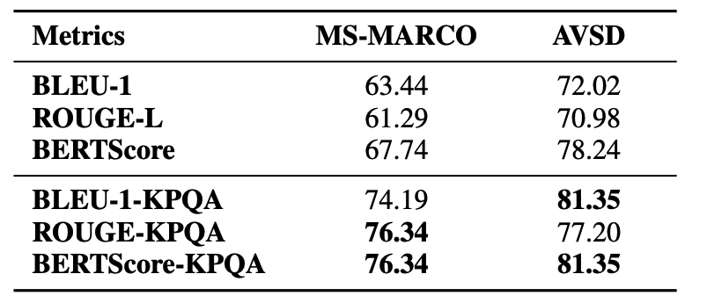
Detailed Experiments: Integrating Keyphrase Weights
Appendix
Correlation with Human Judgments
BERTScore-KPQA
Ranking Experiments
BERTScore
Lee et al., KPQA: A Metric for Generative Question Answering Using Keyphrase Weights, NAACL 2021
Notes:
마지막으로 future work에 대해서 말씀드리겠습니다. future work는 제가 part3에서 설명드린 것처럼 어떻게 factual consistency가 높은 시스템을 만들 수 있는가에 관한 내용입니다. 우선 저는 기존의 likelihood estimation방식, 즉, 단순히 다음 단어를 예측하도록 학습 하는 것에는 한계가 있다라는 점에 주목하였습니다. 단순히 이렇게 사람이 쓴 글을 흉내내는 것만으로는 factual consistency가 높은 텍스트를 생성하기 어렵다는 것입니다.

Slide 77
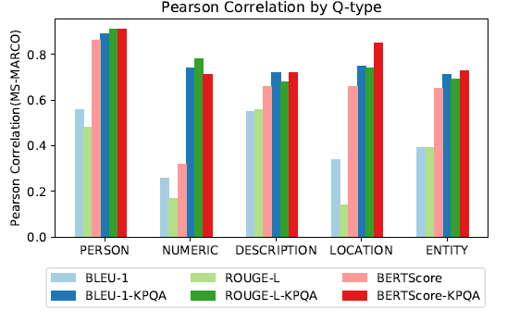
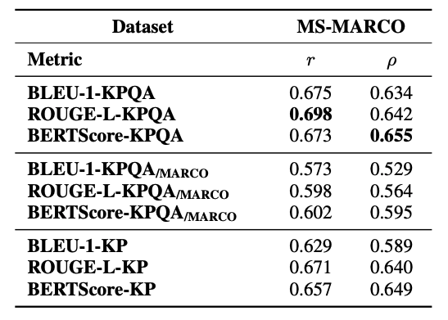
Detailed Experiments: Integrating Keyphrase Weights
Appendix
Correlation by Question Type
Domain Effect
Lee et al., KPQA: A Metric for Generative Question Answering Using Keyphrase Weights, NAACL 2021
Notes:
마지막으로 future work에 대해서 말씀드리겠습니다. future work는 제가 part3에서 설명드린 것처럼 어떻게 factual consistency가 높은 시스템을 만들 수 있는가에 관한 내용입니다. 우선 저는 기존의 likelihood estimation방식, 즉, 단순히 다음 단어를 예측하도록 학습 하는 것에는 한계가 있다라는 점에 주목하였습니다. 단순히 이렇게 사람이 쓴 글을 흉내내는 것만으로는 factual consistency가 높은 텍스트를 생성하기 어렵다는 것입니다.

Slide 78
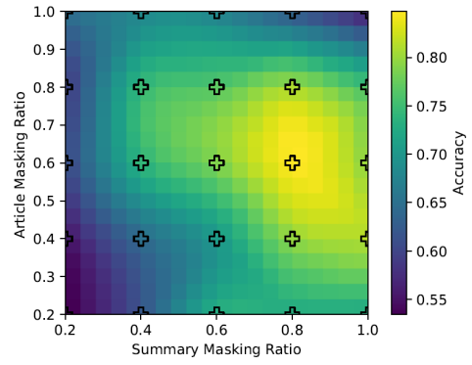
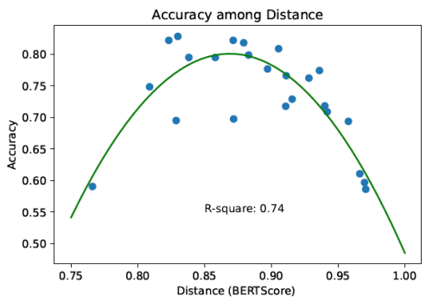
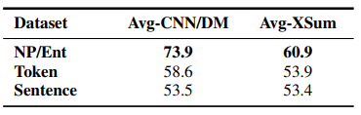
Detailed Experiments: Masked Generation
Appendix
England won 2-0 against Switzerland at St Jakob-Park on Monday night.
Masking
<mask> won 2 - 0 against <mask> at <mask> on <mask>.
How many masks are necessary?
Performance among Masked Ratio
Performance among Distance from Reference Summary
Where should we make masks?
Performance among Masking Unit
Lee et al., Masked Summarization to Generate Factually Inconsistent Summaries for Improved Factual Consistency Checking, Findings of NAACL 2022
Notes:
마지막으로 future work에 대해서 말씀드리겠습니다. future work는 제가 part3에서 설명드린 것처럼 어떻게 factual consistency가 높은 시스템을 만들 수 있는가에 관한 내용입니다. 우선 저는 기존의 likelihood estimation방식, 즉, 단순히 다음 단어를 예측하도록 학습 하는 것에는 한계가 있다라는 점에 주목하였습니다. 단순히 이렇게 사람이 쓴 글을 흉내내는 것만으로는 factual consistency가 높은 텍스트를 생성하기 어렵다는 것입니다.

Slide 79
Appendix
Factual Errors in Text Generation Systems
Intrinsic Error
: System misrepresents information present in the input source
Source:
Germany emerge victorius in 2-0 win against Argentina on Saturday.
Summarization
Summary 1:
Argentina beat Germany 2-0.
The result of the match is wrong.
Maynez et al., On Faithfulness and Factuality in Abstractive Summarization, ACL 2020
Notes:
Then, what is the main challenge in text generation task? Let’s look at simple example in summarization task. In this example, the generated summary from the system says argentia beat genermany, however, in the source, Germany beat argentina. Hence, the result of the match in the summary is wrong, because system misrepresents information in the source. This example is an error called intrinsic error in text generation task.

Slide 80
Appendix
Factual Errors in Text Generation Systems
Extrinsic Error
: System adds information not inferable
Source:
Germany emerge victorius in 2-0 win against Argentina on Saturday.
Summary 2:
Germany beat Argentina at in the 2014 World Cup.
Summarization
We cannot infer the place of this match in the source.
Maynez et al., On Faithfulness and Factuality in Abstractive Summarization, ACL 2020
Notes:
Let’s look at another example. For this summary, the result of the match is correct, but the summary says Germany beat argentina in 2014 world cup. Well, the fact in the summary is correct. Germany actually beat argentina in 2014 world cup. However, we cannot infer the place of this match in the source, and the system added this information. We let the model summarize, but the system did something more and this is an error. These types of errors are called extrinsic error in text generation task.

